Slide 1
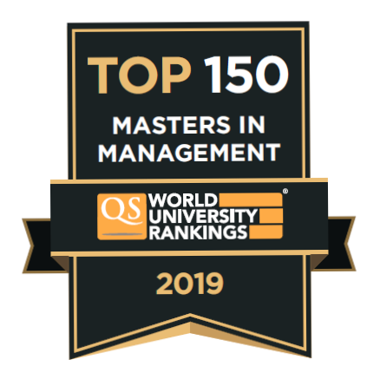
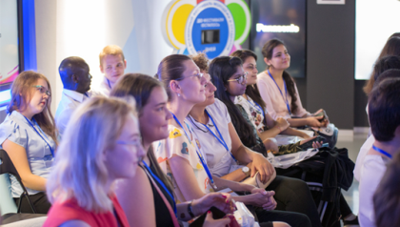
100%
taught in English
MASTER IN INTERNATIONAL MANAGEMENT
The program was founded in 2010 with the aim of preparing highly qualified managers with analytical, leadership and teamwork skills for fast-growing Russian and international companies
Double degree program with the Management School, the University of Liège (EPAS, EQUIS, AACSB), Master 2
The only program in the region with international professional accreditation ACCA (The Association of Chartered Certified Accountants)
Using modern training technologies (simulator “Digital Markstrat”)
Doing Business in Russia, July 20-30, 2020
International Summer School

Slide 2
PROGRAM ADVANTAGES
Double Degrees and ACCA Exams
LIEGE University + ACCA + Oxford Brookes University
Extendent Career Opportunities in Russia and in the World: 4 ACCA Qualification Exams (F1,F2,F3, F7) + a BSc degree in Applied Accounting awarded by Oxford Brookes University + ACCA Privileges ACCA Membership
Internationalization
Semester internship at partner universities
Exchanges window 2-3 semesters, International Summer School for Masters (5 ECTS)
Multi-cultural Invironment
46% of all students in academic groups are foreign students
China, Czech Republic, France, Italy, Germany, CIS
Employers and Corporate Partners

Slide 3
PROGRAM TRACKS AND GRADUATE CAREER
INTERNTIONAL BUSINESS courses: International business Strategie; Global supply chain management; Procurement Technology; Modeling and optimization of business processes
INTERNATIONAL FINANCIAL MANAGEMENT courses: Fanatical management (F9); Value based management; Taxation (F6);Audit and Assurance (F8); Performance management (F5)
Practice-oriented training: research and practice-oriented projects; Introductory Internship, Professional Internship, Research Projects, Thesis Defense
More information: https://urfu.ru/ru/applicant/; https://programs.edu.urfu.ru/ru/10109/

Slide 4
УСЛОВИЯ ПОСТУПЛЕНИЯ
How to apply
https://urfu.ru/en/international/programs-and-courses/master-programs-in-english/international-management/
https://programs.edu.urfu.ru/ru/10109/
Online presentation of the program
https://www.youtube.com/watch?v=ctZbzv4bpm
Contacts:
Liudmila Ruzhanskaya
l.s.ruzhanskaya@urfu.ru
gsem.urfu.ru

